Slide 1

DATA SCIENCE
10 WEEK PART TIME COURSE
Natural Language Processing

Slide 2
AGENDA
Spooky personality information
Getting text ready for machine learning
Spacy
Textacy
Part-of-speech tagging, named entity extraction, noun phrases
Bag-of-words and other techniques
Machine learning with NLP examples

Slide 3
While Greg is talking
pip install spacy
If you get errors on Windows about needing libraries and development tools, install them (e.g. http://aka.ms/vcpython27 )
python –m spacy download en

Slide 4
Testing that spacy is working
import spacy
nlp = spacy.en.English()
text = nlp(u'I am a frog’)
[(token, token.pos_) for token in text]
The output should look something like this:
[(I, u'PRON'), (am, u'VERB'), (a, u'DET'), (frog, u'NOUN')]

Slide 5
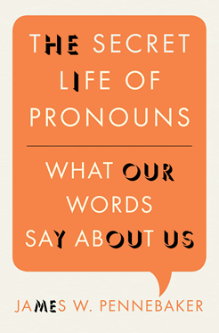
Greg’s Reading Suggestion
How Tweets and Facebook posts can tell us about the personality of their authors.
Why lying to others and to ourselves causes us to talk differently.
How it’s possible to predict if two people will fall in love by counting the function words the two people use in their first conversation with one another.
When we can predict a person’s age, sex, where they live, and what their background is by analyzing their conversations or emails.
Why self-confident leaders rarely use the word “I” and insecure and depressed people do.
How writing about an emotional upheaval using particular linguistic styles can help you get past it.
Why analyzing your own emails, letters, and natural conversations can tell you about yourself and the relationships you cherish most.

Slide 6
From text to features
DATA SCIENCE PART TIME COURSE

Slide 7
What Natural Language Processing looks like
Big blob of text
???
Features for a model

Slide 8
The usual goal
A dataframe
Each row is a document
Columns represent features
Do something with the dataframe:
Predict a column from the others?
Cluster documents?
Title | Number of words | Ratio of personal pronouns | Soliloquy to a skull
Alice in Wonder-land | 34110 | 0.1% | No
Hamlet | 37360 | 0.3% | Yes
Persuasion | 98171 | 0.7% | No

Slide 9
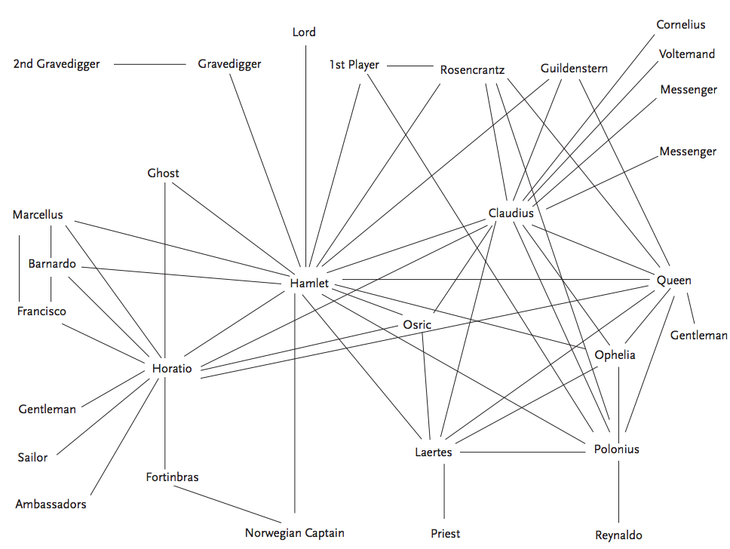
The less-usual goal
See the connections between entities and do network analysis

Slide 10
Methods
Compare against giant corpora
Count occurrences of words
Count occurrences of pairs and triples of words
Take ratios
Find word combinations that are probabilistically unusual
Parse sentences into nouns, verbs, adjectives
Chunk into noun phrases, etc.
Turn sentences into vectors
A large and structured set of texts
e.g. the Brown Corpus, contains 500 samples of English- language text, totaling roughly one million words, compiled from works published in the United States in 1961

Slide 11
Why does this work even without understanding?
Spooky personality effects on writing
http://www.hackerfactor.com/GenderGuesser.php
There aren’t that many ways to say things
We personify / anthropomorphise
Shallow Understanding

Slide 12
Low-level Shallow Deep
Lexical parsing Morphological (word) segmentation Optical character recognition (OCR) Part-of-speech (POS) tagging Sentence boundary disambiguation Speech/phoneme segmentation | Automatic summarization Named entity recognition (NER) Sentiment analysis Speech recognition Topic segmentation and recognition Word sense disambiguation | Machine translation Natural language generation Natural language understanding

Slide 13
Python NLP Packages
 | Pros | Cons
NLTK: Natural Language Toolkit | Well-documented Well-understood | Unsuitable for high-performance applications
Gensim: Topic Modeling for Humans | Built-in distributed computing support Can index datasets larger than RAM Great docs, tutorials | Narrow application focus Smaller support community (than NLTK)
Sklearn | Part of familiar set of tools for Machine Learning Good lib to explore small datasets | Limited set of NLP features “Blows up with memory errors much sooner than other libs”
corenlp: Wrapper for Stanford Core NLP | Stanford Core NLP ... Written in Java | Python wrapper around a package written in Java Relatively little support
spacy | New gold standard for serious NLP work | Less well-known Highly opinionated

Slide 14
Using spacy
DATA SCIENCE PART TIME COURSE

Slide 15
Getting a document
import codecs
f = codecs.open('filename.txt', encoding='utf-8')
# spaCy works with unicode text, not ascii
import spacy
nlp = spacey.en.English()
Text = nlp(f.read())

Slide 16
WORD-SENTENCE SEGMENTATION
The standard approaches to locate the end of a sentence:
If it's a period, it ends a sentence
If the preceding token is in the hand-compiled list of abbreviations, then it doesn't end a sentence
But if the next token after an abbreviation is capitalized, then it ends a sentence.
This strategy gets about 95% of sentences correct.
(Source: Wikipedia)
It fails badly on Markdown documents. It needs a tuned segmenter for this.

Slide 17
Spacey does word and sentence segmentation
Text = nlp(u'This is a sentence. So is this.')
for sentence in Text.sents:
print(sentence)
for word in Text:
print(word.orth_)
# Or split by sentences first
for sentence in Text.sents:
for word in sentence:
print(word)

Slide 18
Lexical diversity
How many different words were used?
How many words in the whole text?
High ratio: rich, intelligent, challenging text
Low ratio: high redundancy, repetitious
Lexical diversity drops in longer documents because eventually there aren’t enough words in any language – so normalise (e.g. middle 10,000 words)

Slide 19
Lexical diversity stability
Most authors have a steady level of lexical diversity in their writing
Uses:
Disputed authorship
Is a passage a quote from somewhere else

Slide 20
Lexical diversity with spaCy – simple version
distinct_words = len(set([token.orth_ for token in Text]))
passage_length = len(Text)
diversity = 1.0 * distinct_words / passage_length

Slide 21
Visualisation and concordancing
DATA SCIENCE PART TIME COURSE

Slide 22
textacy
pip install textacy
Convenient library that uses spacy
nlp = spacey.en.English()
hamlet = nlp(…)
from textacy import text_utils
text_utils.keyword_in_context(hamlet.string, 'scull',
window_width=20)
like a very Drab A Scull ion Fye vpont Foh Ab
eene such Ham That Scull had a tongue in it
ht not that bee the Scull of a Lawyer where b
n dead body Heres a Scull now this Scul has l
head once This same Scull Sir this same Scull
Scull Sir this same Scull sir was Yoricks Scu
ull sir was Yoricks Scull the Kings Iester H

Slide 23
Mini-LAB Which has the longer average sentence: Alice in Wonderland or Emma? Which has the greater lexical diversity? Look at some word usages in context
DATA SCIENCE PART TIME COURSE

Slide 24
Part of Speech Tagging, Entity Recognition
DATA SCIENCE PART TIME COURSE

Slide 25
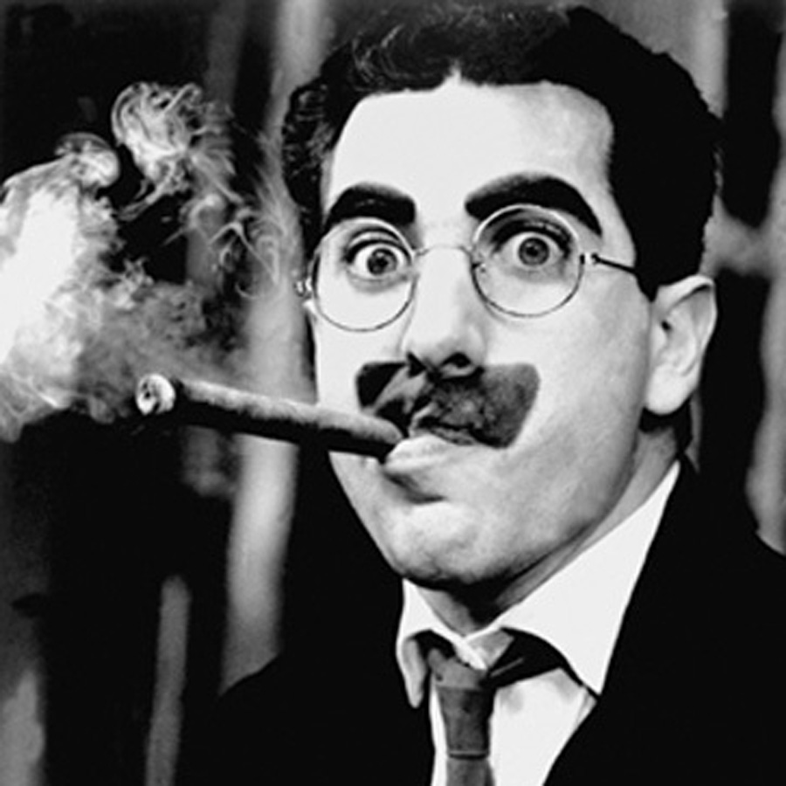
How to parse this sentence?
I shot an elephant in my pyjamas.
(Hint: the next sentence was “how he got into my pyjamas I’ll never know”).

Slide 26
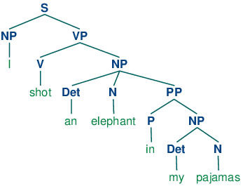
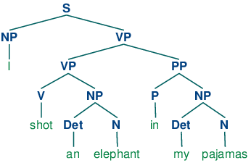
Who was in the pyjamas?

Slide 27
How to parse?
Create probability for each word as a noun, verbs, adjectives, etc.
i.e. Look up a corpus
Assign a probability for each phrase
i.e. Look up a very, very big corpus
Multiply out a lot of big matrices
i.e. Give up when you get something that looks OK
Google’s Parsey McParseface is the leader
Spacey is nearly as good, but much faster

Slide 28
Iterating over a document
s = nlp(u"George Clooney bought a sad frog in Sydney because it was going cheap.")
for word in s:
print(word.text, word.pos_, word.ent_type_)
George PROPN PERSON
Clooney PROPN PERSON
bought VERB
a DET
sad ADJ
frog NOUN
in ADP
Sydney PROPN GPE
because ADP
it PRON
was VERB
going VERB
cheap ADV
. PUNCT

Slide 29
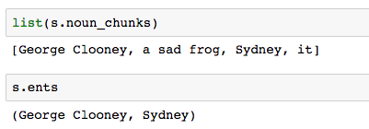
Named Entities and Noun Phrases

Slide 30
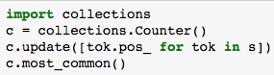
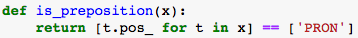
Two Quick Digressions
How to count things:
Is a noun chunk a preposition?

Slide 31
Mini-LAB Parse a sentence, find named entities and work with noun phrases
DATA SCIENCE PART TIME COURSE

Slide 32
Turning sentences into dataframe rows
DATA SCIENCE PART TIME COURSE

Slide 33
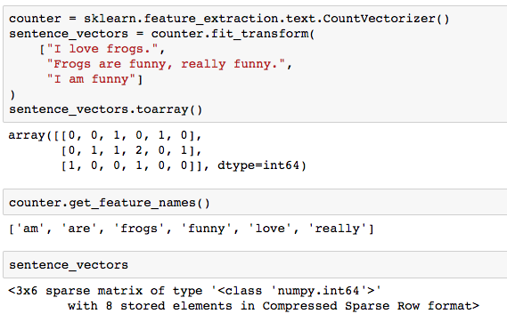
Bag of words
sentence This comprehensible is, is order word unimportant which shows

Slide 34
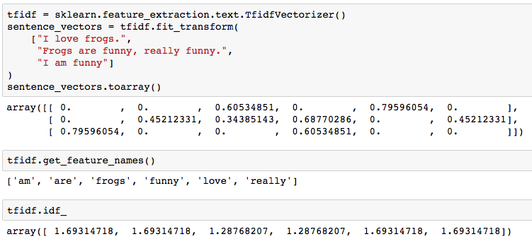
Term Frequency / Document Frequency
Rare words should be worth more than common words
Term frequency times inverse document frequency (TFIDF)

Slide 35
How to use those sentence vectors? / What newsgroup to post in?
import sklearn.linear_model
import sklearn.feature_extraction.text
tfidf = sklearn.feature_extraction.text.TfidfVectorizer()
newsgroups=sklearn.datasets.twenty_newsgroups.fetch_20newsgroups()
vectors = tfidf.fit_transform(newsgroups.data)
lr = sklearn.linear_model.LogisticRegressionCV()
lr.fit(vectors, newsgroups.target)
lr.predict(tfidf.transform(
["Does anyone have a rocketship for sale?”,
"I'd like to buy a used satellite"]
))

Slide 36
EXAMPLE - SENTIMENT ANALYSIS
You have words + some kind of rating
Do machine learning to predict whether a sentence is positive or negative!
Often trained on datasets of measurable positive / negative comments (such as movie reviews)

Slide 37
EXAMPLE – SPAM FILTER
You have email text + spam / ham
Do machine learning to predict whether a sentence is spam or ham
Nigerian princes, viagra, languages you don’t know => predict spam

Slide 38
Mini-LAB Rocchio search
DATA SCIENCE PART TIME COURSE

Slide 39
word2vec
DATA SCIENCE PART TIME COURSE

Slide 40
Match-them-up!
Paris
Melbourne
cricket
tennis
pizza
souffle
I like to play ____ in summer.
I got hit by a ____ ball.
Did you eat all the ______?
I’m sorry, the ____ is off the menu.
______ is the capital city.
If fashion bores you, don’t go to _____.

Slide 41
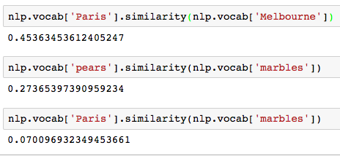
If words get used in similar contexts, they are similar

Slide 42
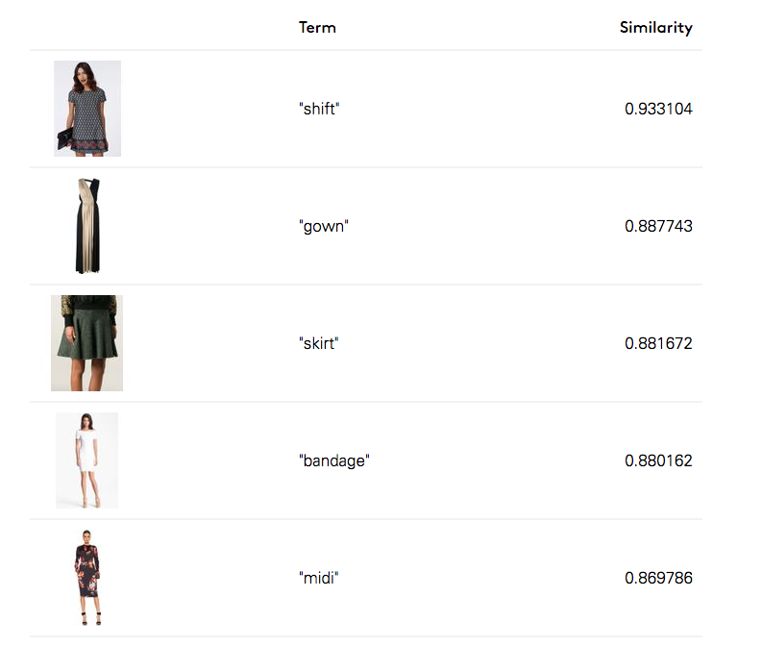
Practical Example
Lyst uses word similarity for search
e.g. what is similar to dress?

Slide 43

How word2vec works
The data scientist picks the number of “topic areas”
e.g. 300
The computer makes a unique random 300-element array for each word
Repeat millions of times:
Pick a word at random
Alter one element its array to make it:
More like the arrays of other words it is similar to.
Less like arrays it isn’t similar to

Slide 44
Fun you can have with word2vec vectors
https://rare-technologies.com/word2vec-tutorial/#bonus_app

